Slide 1
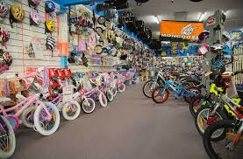
ADVENTURE HARDWARE GROUP
DATA VISUALIZATION AND FORECASTING
DELIVERED BY OYEWUMI IYIOLA FOR PAIRVIEW LTD.

Slide 2
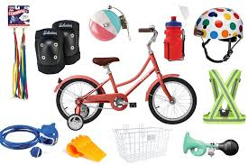
TABLE OF CONTENT
Business overview
Executive summary
Financial and demographics performance
Market share and competitors
Market basket analysis
SALES FORECAST
Conclusion
Ahg strategy
recommendation

Slide 3
BUSINESS OVERVIEW
Adventure Hardware Group (AHG) is a manufacturing company with global operations in regions like America, Europe and Asia. AHG specialty product are bikes, components, accessories, and clothing. We have the dynamics of reaching our customers through our respective reseller shops and our online stores which gives our customers access to seamless experience on the web
10 Business Regions
Online and Reseller channels
4 product categories
119,12k
customers
4 years in business

Slide 4
2. Executive summary – financial analysis
Revenue:
Across the regions, AHG sales and revenue grew to a yearly peak of $43.6m in 2013 from $12.6m in 2011.
Southwest of US region generated the most revenue of 24m, about 21% of the Total Revenue of $109.85m
The Reseller sales channel generated $80.49m , 73% of the Total revenue with the peak revenue occurring in 2013 at $32.9m. While the Online sales generated $29.36m with its yearly peak of $10.7m also occurring in 2013.
Bikes category generated the most revenue from both sales channel ($94.65m) followed by components ($11.8m).
The Reseller bike market ($66.33m) represented more than twice the Online bike market ($28.32m) in terms of revenue generated .Southwest(US) is the region with the highest revenue through Reseller channels while Australia with the least reseller sales ($1.6m) generated the highest revenue ($9.06m) in the Online sales.
Profit: The Peak Yearly Profit of $4.2m occurred in 2013 from an overall profit of $12.59m.
Although the Reseller sales generated more revenue, Online sales generated the most Profit (12.08m). This is largely due to the discounting policy on Reseller sales. The Reseller Bike market made losses and no profit. The discounting policy also led to losses in Components and Clothing with the exception of Accessories.
Southwest (US), France , Germany and Australia all made losses through the reseller channel while Australia made the highest profit through the Online sales $3.86m.This is suggestive of a shift towards the Online sales channel.

Slide 5
2. Executive summary – financial analysis cont’d
Overall, Bikes category generated the most profit with $10.55m followed by Components.
Promotion and price were the major Sales reasons that influenced the profit through the Online sales channel .
A total loss of $0.96m was made from the bikes category through Reseller . This was majorly caused by the discounting policy on Reseller market.
Mountain-200 Black,38 was the most profitable product generating $590k online and $282k through resellers.
Customer Demography: No major changes were seen in the customer demography affecting Sales.
Supply Chain: The shipping price increases YoY. AHG should review the services of Cargo transport and ZY-express for better rate and faster delivery times.
The Average Planned cost has been the same as Average actual cost. This should be reviewed for proper data capturing.
Competitor Analysis: AHG ‘s Bike prices are relative with the market price when compared to Alltricks and Canyon. It only needs to include additional services like return policy, financing, servicing and online customer care services to help improves its sale.
5 years Forecast: The Online revenues generated in Germany, United Kingdom and France followed a similar pattern, with the UK leading with $574k in Q1 2014. The 5-years forecast also showed similar upward trend with about 150% increase at Q4 2019 .
Canada had a Maximum Reseller forecast revenue of 64.8% above the actual peak revenue generated in Q3 2013.
Northeast region had maximum forecast revenue as 12.8% less compared to maximum actual revenue($919k).
Market basket Analysis : Mountain 300 Black,44 and Mountain Rear Wheel gave 30% profit more than with Full Finger Gloves with Mountain 300 Black,44 .

Slide 6
3. FINANCIAL AND DEMOGRAPHIC PERFORMANCE
SUMMARY OF FINANCIAL INFORMATION
IS THERE A SHIFT TOWARDS DIGITAL?
IS THE BUSINESS MAKING PROFIT?
CUSTOMER DEMOGRAPHICS ONLINE
WHICH AREAS SHOULD THE BUSINESS IMPROVE

Slide 7
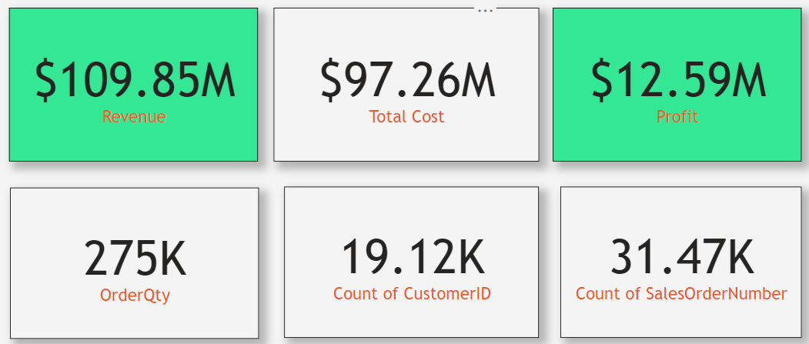
3.1 SUMMARY OF FINANCIAL INFORMATION
COMMENTS:
The Company generated $109.85m revenue from its inception in 2011 to Q2 2014.
Total profit generated from all sales through both sales channel is $12.59m with total product cost of $97.26m
275,000 quantities of products have been sold through 31.47k orders and by 19.12k customers.

Slide 8
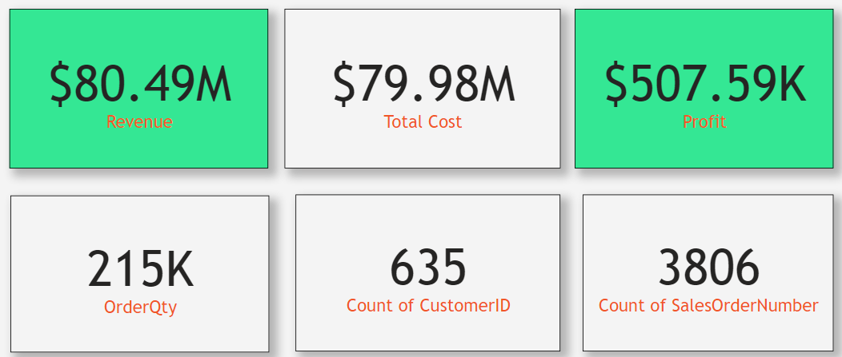
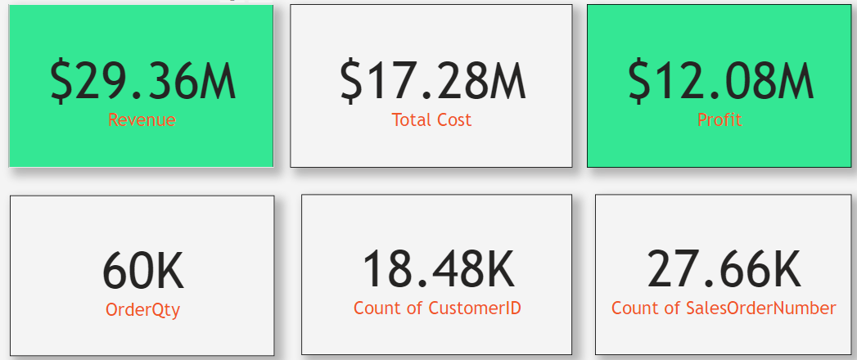
3.1.1 Sales channels FINANCIAL summary
RESELLER SALES
ONLINE SALES
COMMENTS:
Although the Reseller sales generated a revenue of $80.49m,Online sales with a revenue of $29.36m generated more profit with more numbers of customers.

Slide 9
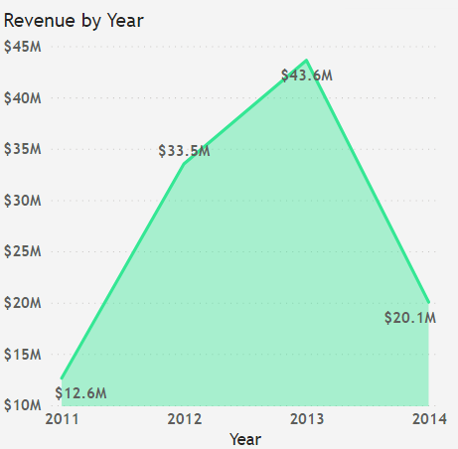
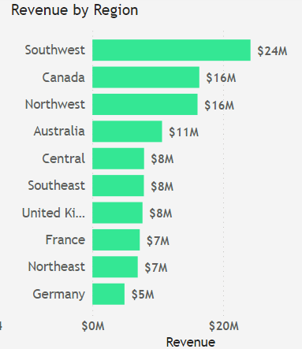
3.1.2 revenue summary
COMMENTS:
$20.1m was generated in Q2 2014, 46% of the value generated in 2013. (Note) Data exist only for 2 quarters in 2014 .
Northwest , Southwest , Northeast, Central and Southeast, all regions in United States of America with the southwest region generating the highest revenue of $24M.

Slide 10
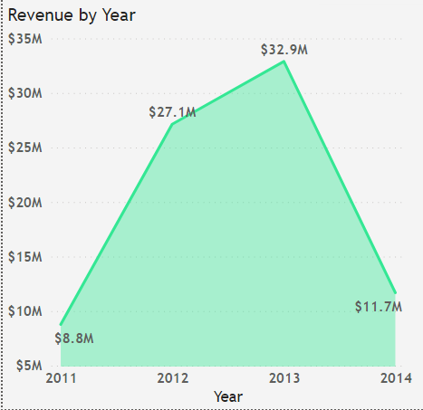
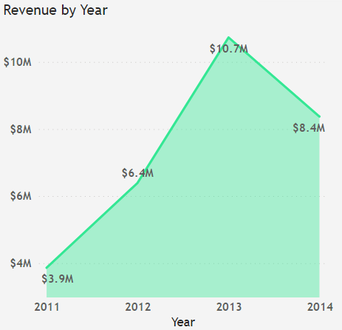
3.1.2 revenue cont’d
RESELLER SALES
ONLINE SALES
COMMENTS:
Both Reseller sales and Online sales generated their peak revenues in 2013.
Reseller revenue declined with 64% compared to 21.5% decline from Online sales between 2013 and Q2 2014.

Slide 11
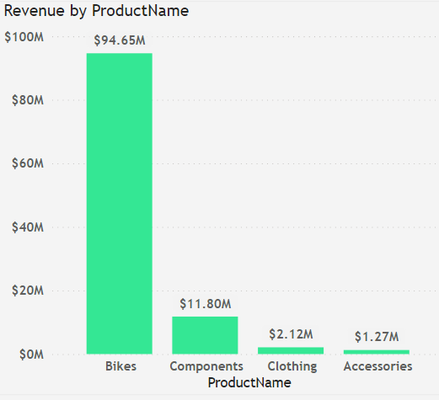
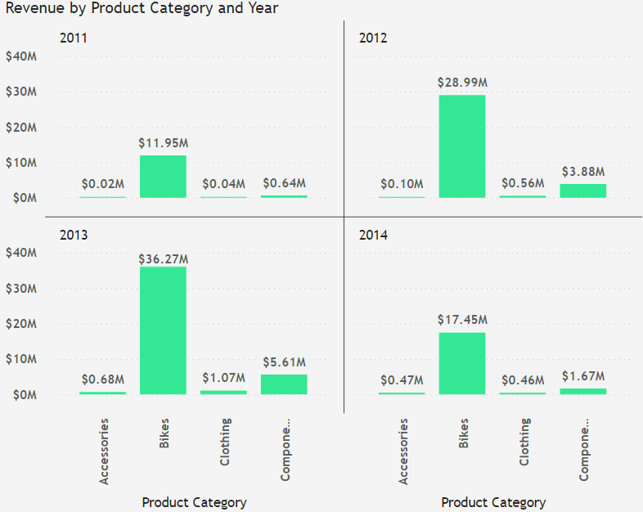
3.1.3 revenue and product INFORMATION
COMMENTS:
Bikes category generated the most revenue followed by components .
Between 2011 and 2013, the revenue generated by the bike sales improved to a peak of $36.27m in 2013.
Components category showed similar positive gain in revenue.

Slide 12
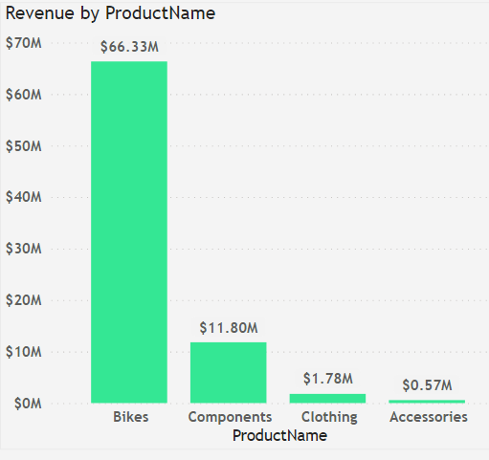
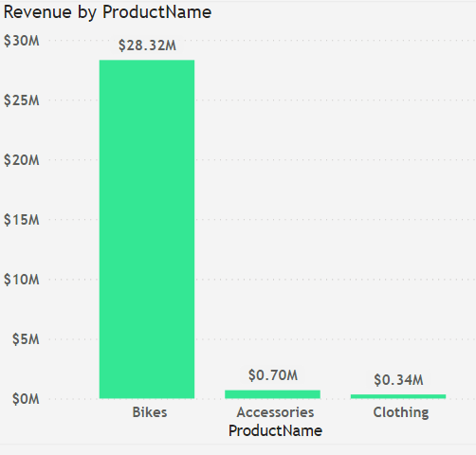
3.1.3 revenue and product INFORMATION cont’d
RESELLER SALES
ONLINE SALES
COMMENTS:
The Bike market generated most revenue from both sales channel.
All revenue from the Components category came from the Reseller sales.
The Reseller bike market represented more than twice the Online bike market in terms of revenue generated.

Slide 13
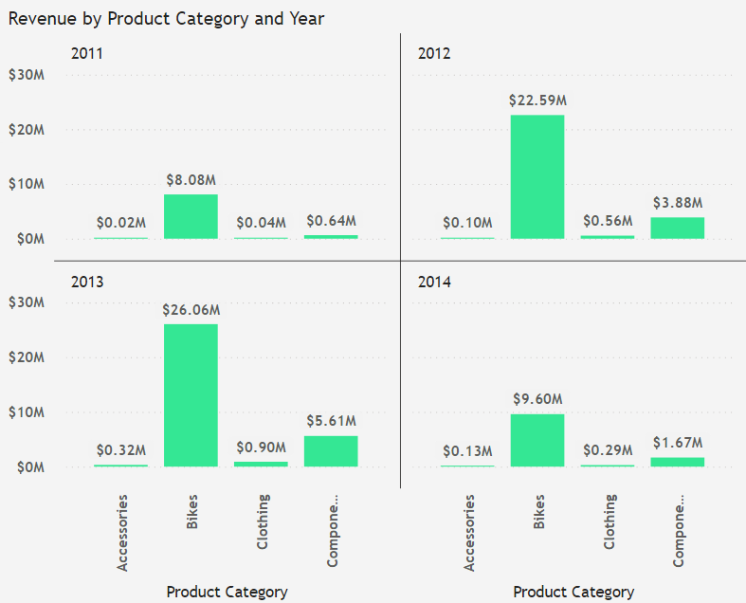
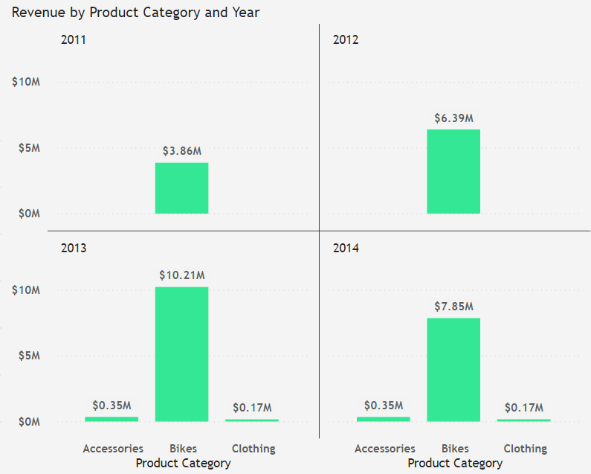
3.1.4 revenue and product INFORMATION
RESELLER SALES
ONLINE SALES
COMMENTS:
Bikes category generated the highest revenue year in year out for both Reseller and Online sales Channels .
The component category was only sold through the reseller channels .
The year 2013, had improved bike sales through both sales channels and generated the highest revenue.

Slide 14
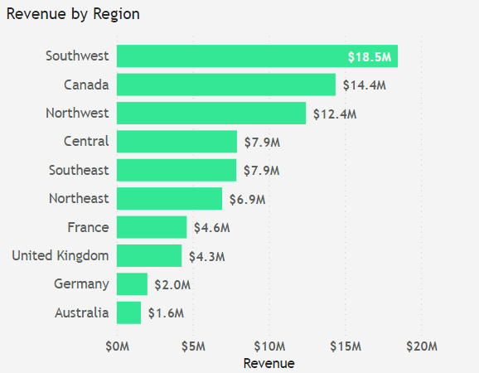
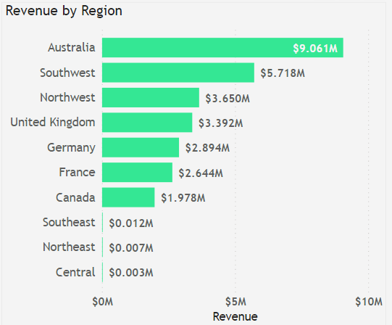
3.1.5 revenue and sales channels
RESELLER SALES
ONLINE SALES
COMMENTS:
The Revenue generated in the southwest region of US showed good patronage with $18m and $5.7m for both Reseller and Online sales.
Australia with the least reseller sales generated the highest revenue in the Online sales.
Online sales in Germany is also higher than the revenue generated through the Reseller sales.
These suggests a shift towards the online sales channel in these countries.

Slide 15
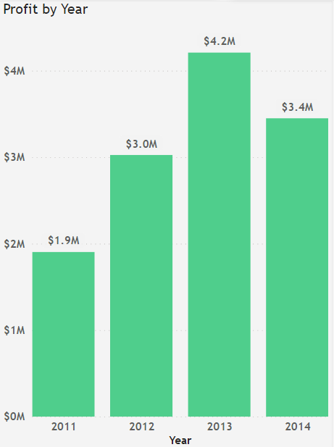
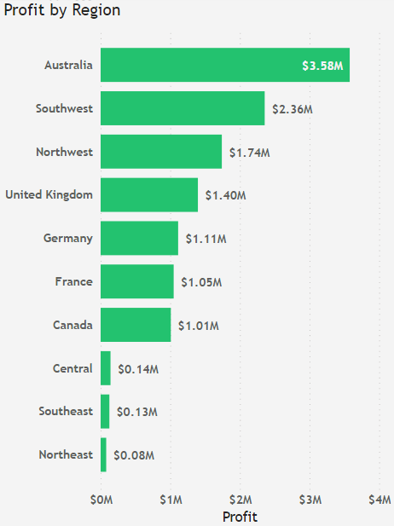
3.3 is the business making profit ?
COMMENTS:
Profit generated over the years was peak of $4.8m in 2013.
Note 2014 has data for Q1 and Q2 only, and also generated $3.4m , about 81% of total profit generated in 2013.
Australia tops the regions as the most profitable with $3.6m

Slide 16
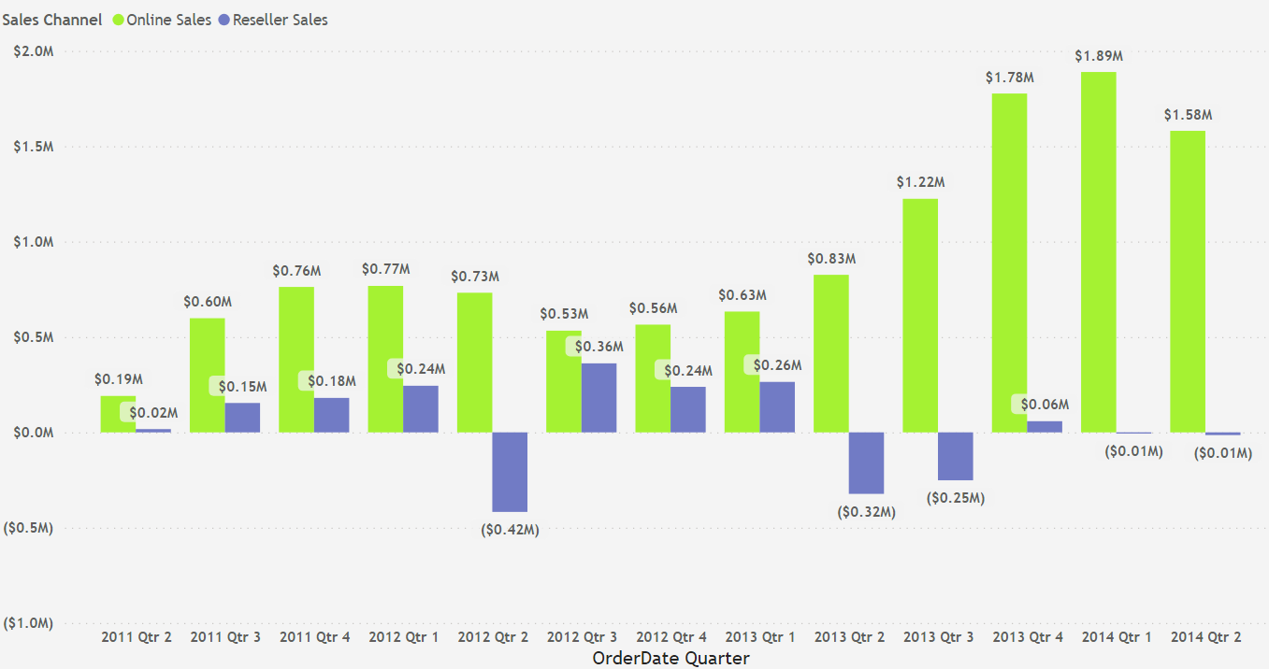
3.3 is the business making profit ?
COMMENTS:
Both sales channels experienced profit through the business period in view except for Q2 2012 , Q2 2013 and Q3 2013 with losses of between $0.4m to $0.25m all from the Reseller channel.

Slide 17
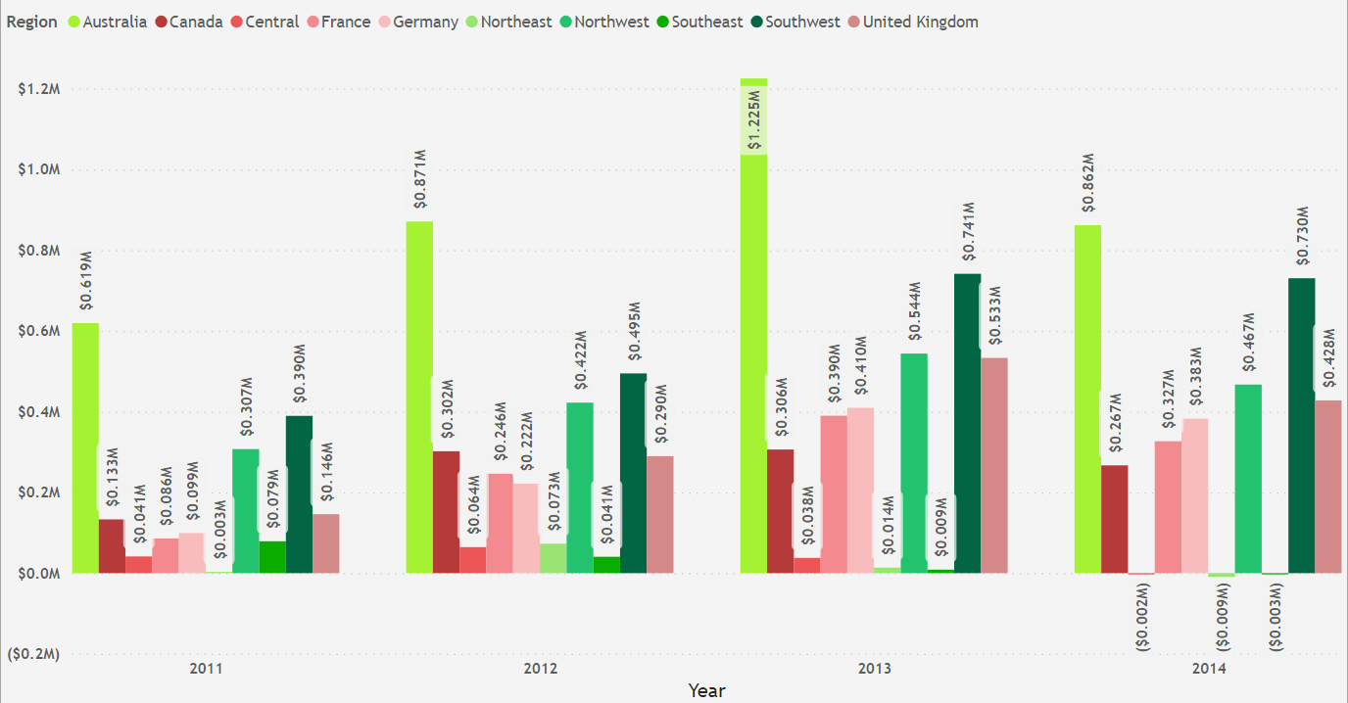
3.3 is the business making profit ?
COMMENTS:
Most regions made profit throughout the years with the exception of Central, Northeast and Southeast region of US with losses in the first 2 quarters of 2014.
The highest yearly generated profit per region is $1.225m (Australia) in 2013.

Slide 18
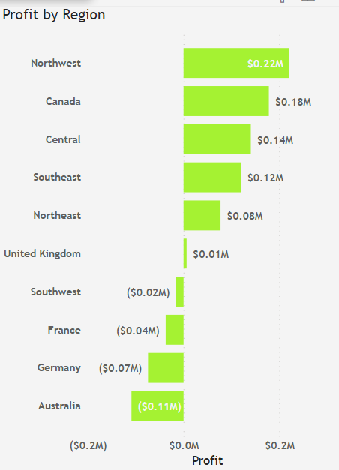
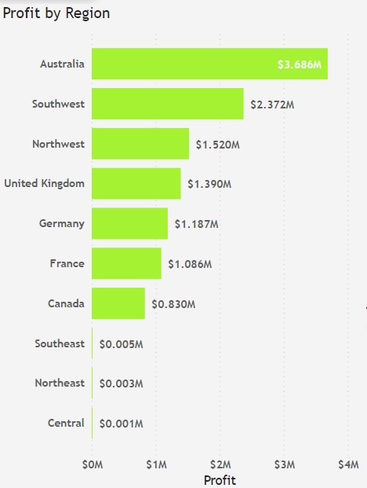
3.3 is the business making profit ? yes
RESELLER SALES
ONLINE SALES
COMMENTS:
All regions made profits through online sales with Australia at the top of the list ($3.69m), a trend to show shift towards digital.
While through the reseller channel, Australia made the biggest loss ($0.11m), followed by Germany.

Slide 19
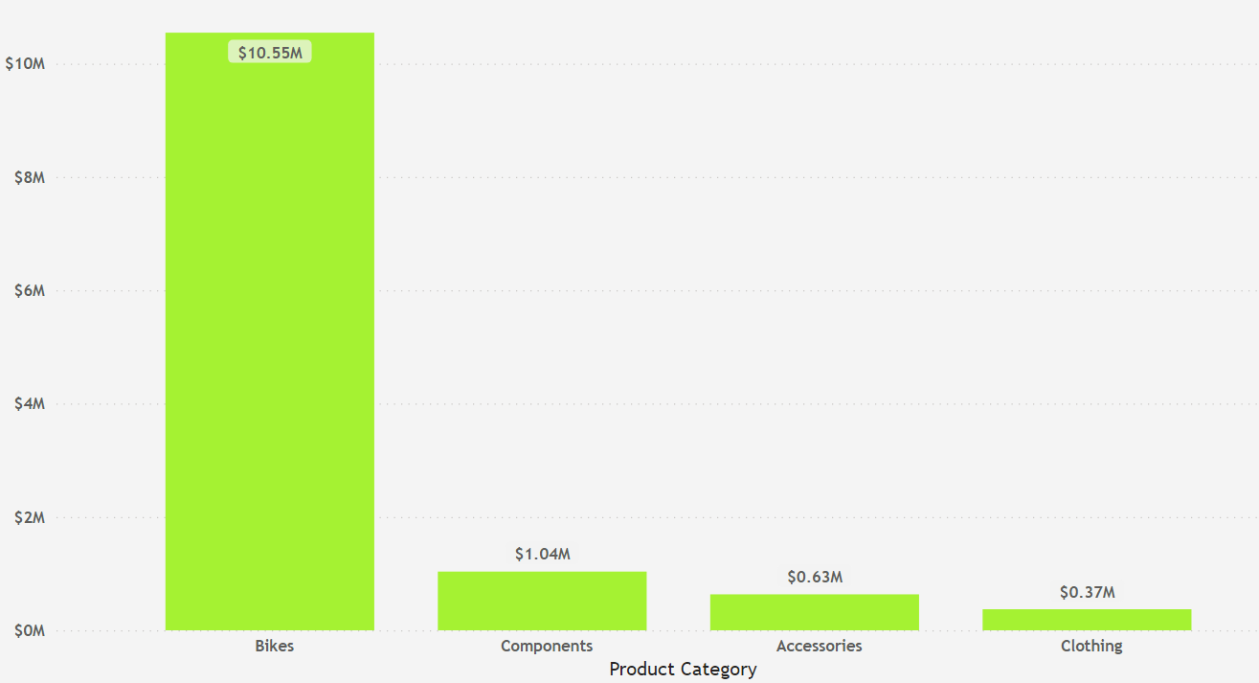
3.3 is the business making profit ?
PROFIT BY PRODUCT CATEGORY
COMMENTS:
The Bikes product category generated the most profit year in year out followed by components.

Slide 20
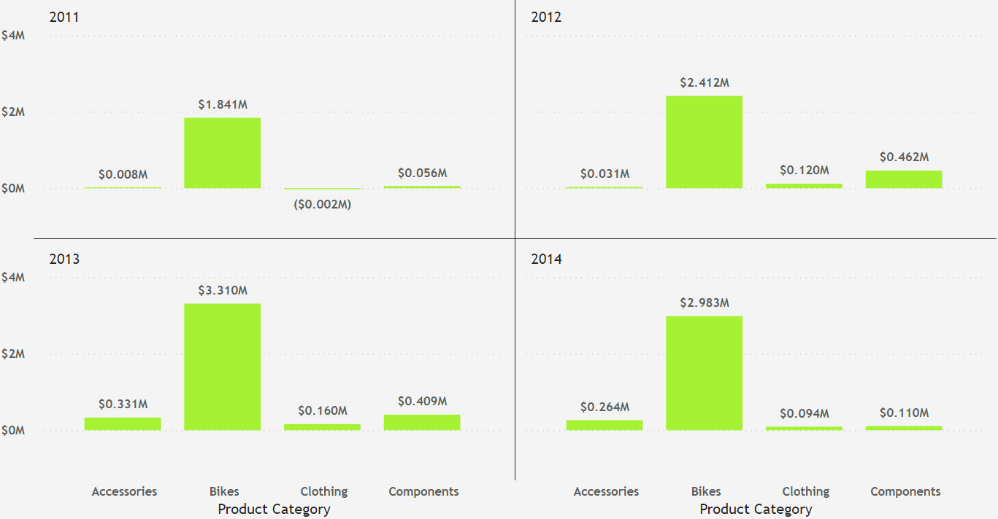
3.3 is the business making profit ? yes
PROFIT BY YEAR AND PRODUCT CATEGORY
COMMENTS:
The Bikes product category generated the most profit year in year out followed by components.

Slide 21
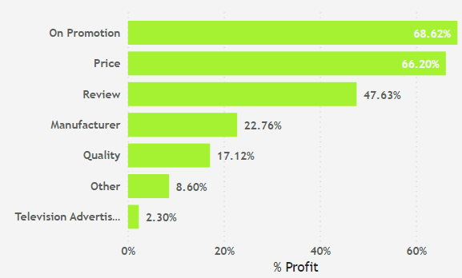
3.3 is the business making profit ?
PERCENTAGE PROFIT BY SALES REASON
COMMENTS:
Television Advertisement contributed the least to profit.
This should be reviewed to ascertain the need to continue it.

Slide 22
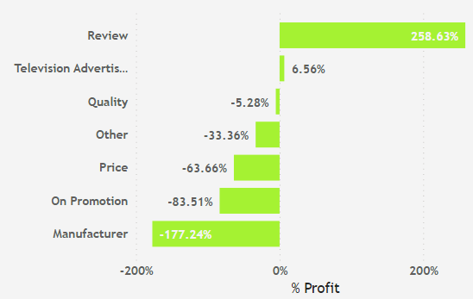
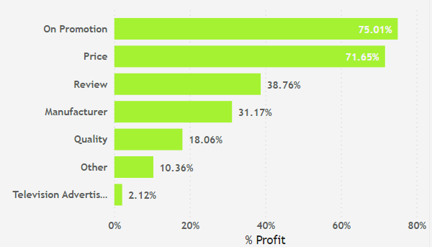
3.3 is the business making profit ? yes
RESELLER SALES
ONLINE SALES
COMMENTS:
Promotion and price were the major reasons for the profit through the Online sales channel.
Manufacturer and Promotion were major contributors to losses made in Reseller channel. This need to be investigated further.

Slide 23
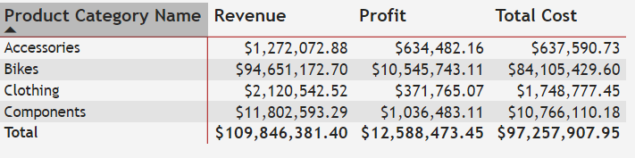
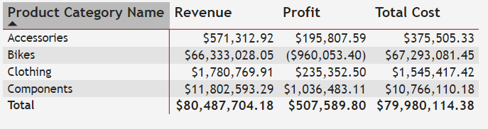
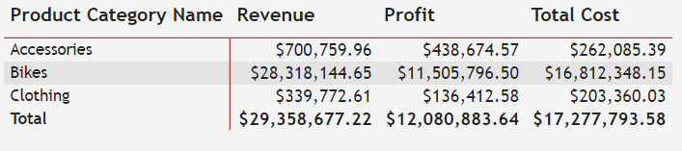
3.3 is the business making profit ?
COMMENTS:
Overall, Bikes category generated the most profit with $10.55m followed by Components.
95% of the profit generated from the bike markets were through the online sales channel.
A total loss of $0.96m was made from the bikes category through Reseller.
All profits from the components were from the Reseller channels .
RESELLER SALES
ONLINE SALES

Slide 24
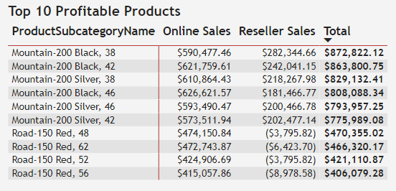
3.3 is the business making profit ?
COMMENTS:
Top 10 profitable products were all in the Bikes category.
Road Bikes 150 made profit in the Online Sales channel and losses in the Reseller channel.

Slide 25

3.3.1 Discounting policy
Discounts have been applied through the Reseller sales channel to help improve sales and drive the revenue up.
This had varying effects on different Product Category. The effects can be categorized as below:
Discounts leading to profit, where Average Unit Price is greater than Average Standard Cost
Discounts leading to losses, where Average Unit Price is less than Average Standard Cost
No Discount leading to Profit, where Average Unit Price Is greater than Average Standard Cost.
If the discount percentages were reviewed for products affected by Category ‘2’ above , profit would be made. This would mean that the discount percentages applied would be to ensure that the Average Unit Price does not go below the Average Standard Cost Price.

Slide 26
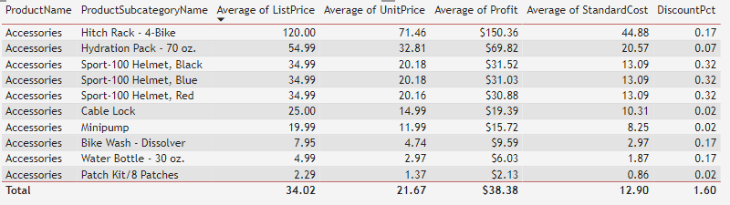
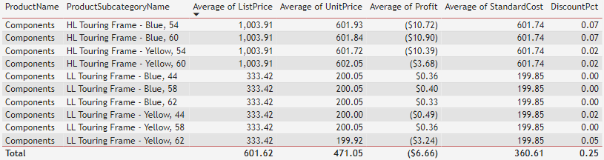
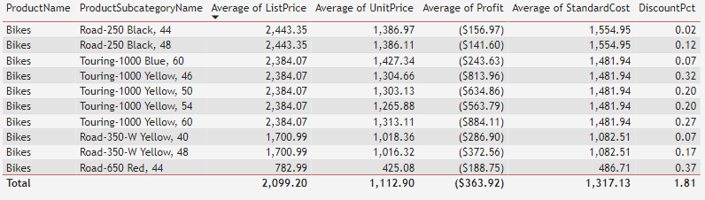
3.3 discounting policy - Reseller channel
BOTTOM 10 PROFITABLE PRODUCTS
Discount = Profit
Avg.Standard cost < Avg.Unit Price
No discount = Profit
Avg.Standard cost < Avg.Unit Price
Discount = Losses
Avg.Standard cost > Avg.Unit Price

Slide 27
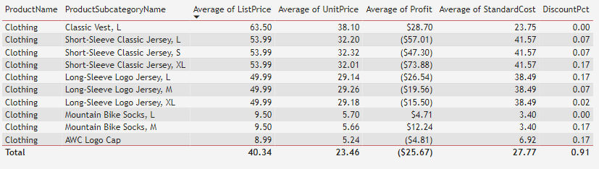
3.3 discounting policy - Reseller channel
No discount/discount = Profit
Avg.Standard cost < Avg.Unit Price
Comments:
Accessories : Discounts on product did not negatively affect the profits.
Bikes : Losses were made due to the discount on products.
Clothing : Most products with discount were negatively affected.
Components: Products with discount made losses while those without discount made profits.

Slide 28

3.4 CUSTOMER DEMOGRAPHY - ONLINE sales channel
The profile for the Ideal customers based on demography from the data analyzed will be:
Married, Males or Females, House owners, Professional English Occupation, having 2 cars with commute distance of 1-2 miles, Graduate of English Education with no children and having yearly income greater than $5000 but Less than $10,000.
This information can significantly increase the efficiency of the marketing campaign by targeting customers within these demographics for improved sales and profit.

Slide 29
3.4 CUSTOMER DEMOGRAPHY - ONLINE sales channel
The Demography of the Customers who made purchases through the Online Sales Channel are:
Marital Status.
Gender.
Age Groups
House Ownership
English occupation
Number of cars Owned
English Education
Commute Distance
Total Number of Children
Yearly Income Groups

Slide 30
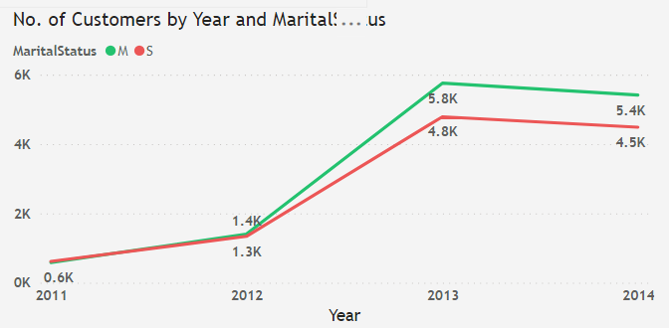
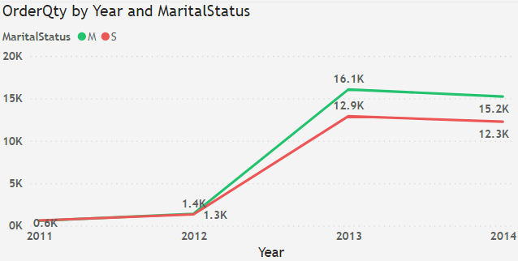
3.4 CUSTOMER DEMOGRAPHY ONLINE – MARITAL STATUS
COMMENTS:
Between 2012 and 2013 , the number of Married (M) customers then surpassed that of singles (S) in the remaining years respectively.
The quantities of products ordered also showed a similar pattern from 2012 onwards.

Slide 31
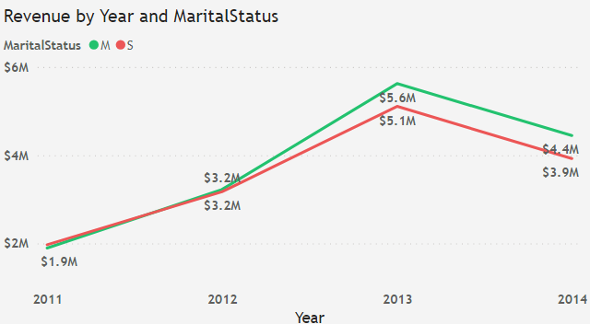
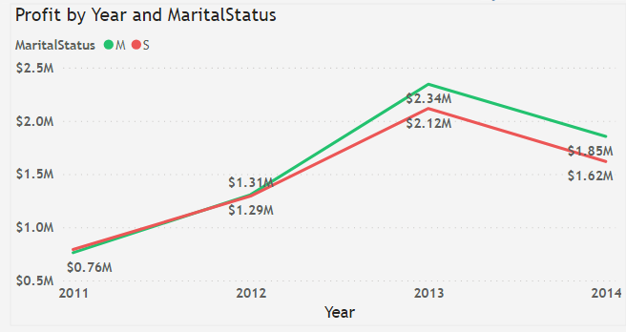
3.4 CUSTOMER DEMOGRAPHY ONLINE – MARITAL STATUS
COMMENTS:
Revenue and Profit generated by single customers started out better in 2011 surpassing the married customers.
A change in both revenue and profit occurred between 2012 and 2013.
The Male customers generated more revenue and profit.

Slide 32
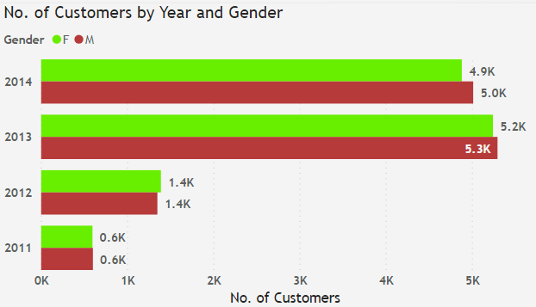
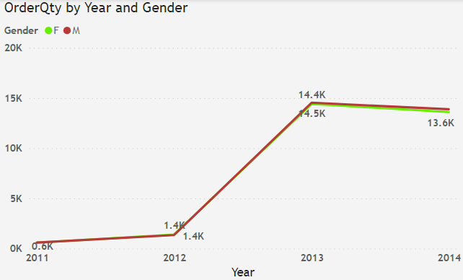
3.4 CUSTOMER DEMOGRAPHY ONLINE - GENDER
COMMENTS:
2013 and 2014 showed more male customers and more products ordered

Slide 33
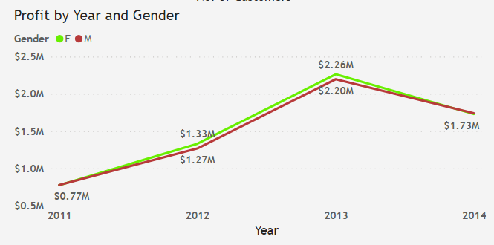
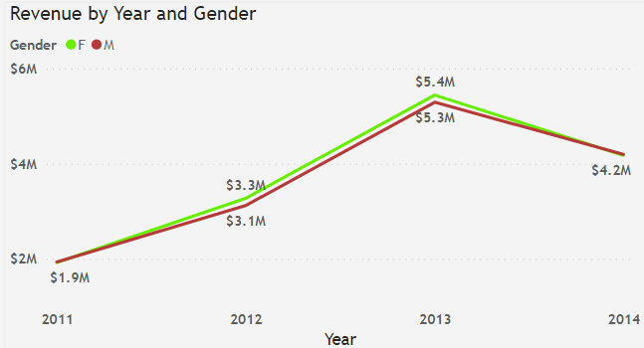
3.4 CUSTOMER DEMOGRAPHY ONLINE - GENDER
COMMENTS:
Although there were more male customers and more products ordered by the male customers, the female customers generated more revenue and profit from 2011 to 2013.
2014 showed a change in revenue and profit with the male generating more.

Slide 34
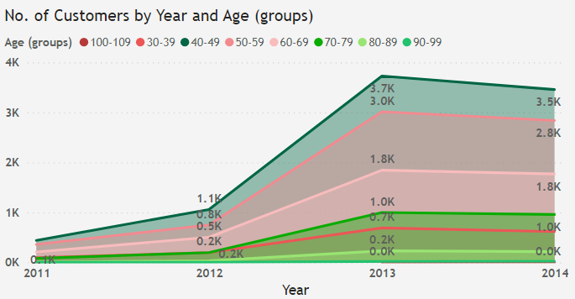
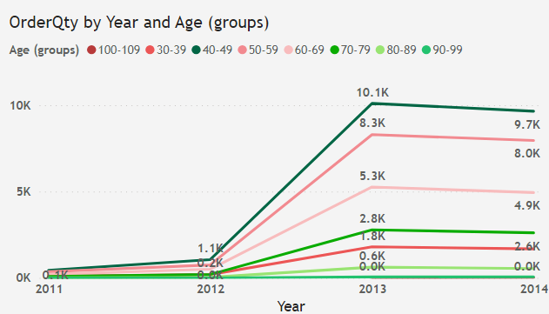
3.4 CUSTOMER DEMOGRAPHY ONLINE – AGE GROUPS
COMMENTS:
No visible change is seen for both number of customers and order quantity .
Customers with age group 40-49 were more and made more orders while those with 50-59 trails behind throughout the business years in review.

Slide 35
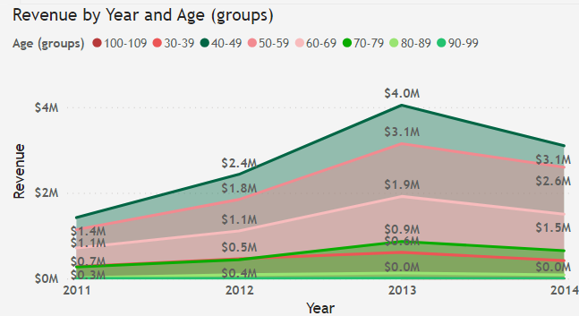
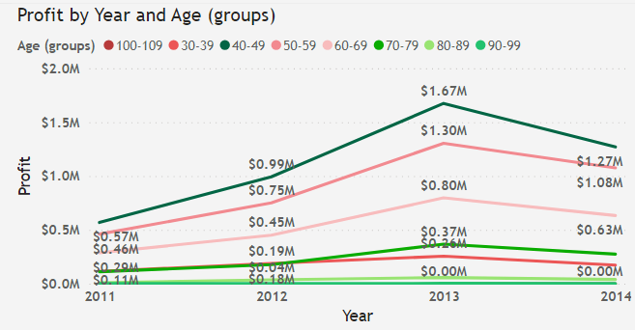
3.4 CUSTOMER DEMOGRAPHY ONLINE – AGE GROUPS
COMMENTS:
The customers within age group 40-49 made the highest revenue and profit, followed by those within the 50-59 age group.
There was a shift in 2012 when the 70-79 age group had revenue and profit generated surpassing that of 30-39 age group, a trend that continued to 2014.

Slide 36
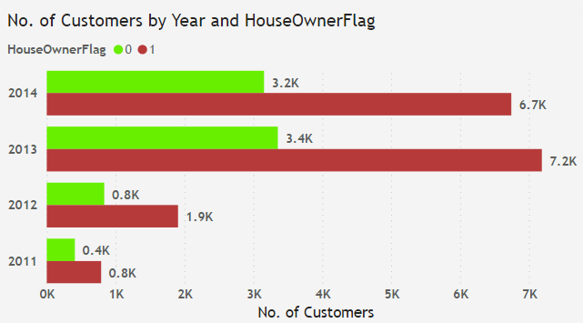
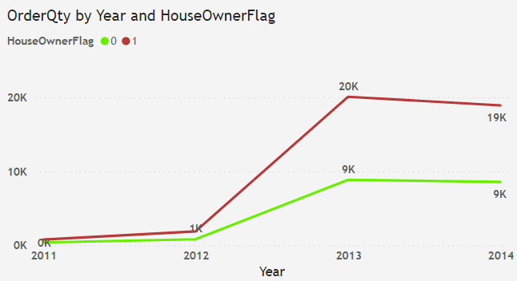
3.4 CUSTOMER DEMOGRAPHY ONLINE – HOUSE OWNERSHIP
COMMENTS:
There were increasingly more customer who had a home than those without one. The Order quantities also followed the same pattern.

Slide 37


3.4 CUSTOMER DEMOGRAPHY ONLINE – HOUSE OWNERSHIP
COMMENTS:
The Customers with a home generated more revenue and profit throughout the review period.

Slide 38


3.4 CUSTOMER DEMOGRAPHY ONLINE – ENGLISH OCCUPATION
COMMENTS:
Between 2011 and 2012,a change was seen between numbers of management and clerical customers .

Slide 39


3.4 CUSTOMER DEMOGRAPHY ONLINE – ENGLISH OCCUPATION
COMMENTS:
Customers with Professional and Skilled manual English Occupation generated more revenue and profit through the years in review.

Slide 40


3.4 CUSTOMER DEMOGRAPHY ONLINE – NUMBER OF CARS OWNED
COMMENTS:
There were more customer who had zero cars in 2011, a trend that changed in 2012 to Customers having 2 cars as the highest .
This translated to most order quantities from customers with 2 cars.

Slide 41


3.4 CUSTOMER DEMOGRAPHY ONLINE –NUMBER OF CARS OWNED
COMMENTS:
The customers with 2 cars owned, generated the most revenue and profit throughout the years .
Between 2012 and 2013, customers with zero cars generated an improved revenue and profit surpassing those with 1,3 and 4 cars. This trend was reversed within Q1 and Q2 2014 with zero car customers generating the lower.

Slide 42


3.4 CUSTOMER DEMOGRAPHY ONLINE – ENGLISH EDUCATION
COMMENTS:
There is a decline in number of customers and orders placed by Graduate degree holders between 2013 and 2014.

Slide 43


3.4 CUSTOMER DEMOGRAPHY ONLINE – ENGLISH EDUCATION
COMMENTS:
Revenue and profit for Graduate degree holders between 2011 and 2012 surpassed those of High school’s .

Slide 44


3.4 CUSTOMER DEMOGRAPHY ONLINE – COMMUTE DISTANCE
COMMENTS:
Both Number of Customers and Order quantities changed for Customers with 5-10 mile commute distance in Q2 2011 rising above those of 1-2 miles commute distance.
The order quantities followed the same pattern as the number of customers.

Slide 45


3.4 CUSTOMER DEMOGRAPHY ONLINE – COMMUTE DISTANCE
COMMENTS:
The revenue and profit generated by customers in the 0-1 miles group was highest, year in year out.
There was an increase in profit made from group 1-2 miles in 2012

Slide 46


3.4 CUSTOMER DEMOGRAPHY ONLINE – TOTAL CHILDREN
COMMENTS:
Changes were seen in 2011 and 2012 between customers having 2 children and those with 1 child.

Slide 47


3.4 CUSTOMER DEMOGRAPHY ONLINE – TOTAL CHILDREN
COMMENTS:
Changes were seen through out the years with both revenue and profit generated between customers with1,2 and 4 children.

Slide 48


3.4 CUSTOMER DEMOGRAPHY ONLINE – YEARLY INCOME GROUPS
COMMENTS:
The higher the number of customer from a group, the higher the order quantitates.
No change in demography was seen in these groups throughout the years

Slide 49


3.4 CUSTOMER DEMOGRAPHY ONLINE – YEARLY INCOME GROUPS
COMMENTS:
Customers who earn > $5000 yearly income generated most revenue and profit, year in year out.
No change was seen.

Slide 50
3. 4 CUSTOMER DEMOGRAPHY – summary
2014 showed an improvement in revenue and profit generated by male demography.
Between 2011 and 2012, a change was seen in the Management and Clerical English Occupation which did not reflect in the revenue and profit.
In 2012, age group 70-79 had revenue and profit generated surpassing that of 30-39 age group with no visible change seen in the number of customers.
There were more customer who had no cars in 2011. In 2012, Customers having 2 cars became the highest . Between 2012 and 2013, customers with zero cars generated an improved revenue and profit surpassing those with 1,3 and 4 cars.
The revenue and profit generated through customers within the number of cars demography did not mimic the change seen in the number of customers.
The number of customers and orders placed by High school holders improved slightly above those of Graduate degrees between 2013 and 2014 although no effect was seen in the revenue and profit generated by these customers.
A change was seen with both Number of Customers and Order quantities for Customers with 5-10 mile commute distance in Q2 2011 rising above those of 1-2 miles commute distance.
Changes were seen in 2011 and 2012 between customers having 2 children and those with 1 child, driving both Revenue and Profit.
No change in demography was seen in the yearly income groups throughout the years

Slide 51

3.5 arears to improve
AHG can improve the Revenue and Profit by looking critically at the factors listed below:
The percentage of work orders affected by scrap
Scrap Quantity
Cost of Production
Manufacturing Process
Shipping cost
Shipping Duration
A proper review of these activities would clearly reduce the overall cost of production and give room for profit .

Slide 52

3.5 arears to improve – work orders
COMMENTS:
The percentage of work orders affected by scrap, increased in most of the years. This should not be the case.
Process improvement to reduce rework and scrap quantity would benefit the company.

Slide 53

3.5 arears to improve – scrap products
COMMENTS:
The Manufacturing process for the Top 10 scrap products should be reviewed .
Quality assurance must be fully implemented in the company to avoid losses due to defective end products.

Slide 54

3.5 arears to improve – scrap reasons
COMMENTS:
Scrap reason names responsible for scrap quantity increase over the years needs to be reviewed – This is a critical issue.

Slide 55

3.5 arears to improve – cost of manufacturing
COMMENTS:
The Average Planned cost is the same as Average actual cost.
Its either the process is 100% accurate or the data has been manipulated. This needs to be looked into for possibility of improper data capturing or fraud.

Slide 56

3.5 arears to improve – manufacturing process
COMMENTS:
Delays in the manufacturing process should be looked into for causes.
The delays of greater than 11 days is actually not acceptable as this has negatively impacted the production cost and profit.

Slide 57


3.5 arears to improve – freight cost
COMMENTS:
The shipping price increases YoY.
AHG should review the services of Cargo transport and ZY-express for better rate and faster delivery times.

Slide 58


3.5 arears to improve – rejected quantities
COMMENTS:
The Rejected quantity increases YoY.
AHG should review the services of Cargo transport and ZY-express to reduce rejects.

Slide 59

3.5 arears to improve - order quantity
COMMENTS Overall:
2013 is the year with the highest orders of 136k products.﻿
Total orders in 2 quarters of 2014 is about 96% of that of 2012.
It is obvious that at the end of the year 2014, the total orders will be higher than that of 2012.

Slide 60


3.5.2 arears to improve – SALES CHANNEL
ONLINE SALES
RESELLER SALES
COMMENTS Overall:
Online sales recorded highest number of products ordered in 2013 at 33.5k products, a 4.7 percent higher than 2014(only 2 quarters data available).

Slide 61

3.5.3 arears to improve - PRODUCT CATEGORY
COMMENTS: Online
Both Reseller and Online Sales channel had most orders in 2013.
Accessories had an improved order quantities from 6k in 2012 to 35k in 2013.

Slide 62

4.
Competitors and their regions listed below:
﻿﻿Alltricks – France
Halifords – United Kingdom
Schwinn - USA
Bike Online – Canada
Canyon - Germany

Slide 63
4. Competitor analysis – ahg revenue by year & region
Total Bike sales:
US and Canada are the regions with highest Revenue generated.
2014 has data for only 2 quarters

Slide 64
4. Competitor analysis – Maximum unit price
Competitors on Price:
﻿﻿Alltricks and Canyon have both Mountain and Road bikes with high prices compared to AHG and the rest.
AHG ‘s price is relative with the market price looking at Schwin and Bikes Online prices.

Slide 65
4. Competitor analysis – minimum unit price
Competitors on Price:
AHG has the lowest unit price for both bike types. This would attract customers with low earnings and purchasing power.

Slide 66
4. Competitor analysis – PRODUCT (BIKE types)
COMPANY | MOUNTAIN BIKES | ROAD BIKES | TOURING BIKES | KIDS BIKES | E-BIKES | BMX BIKES
AHG
HALIFORDS
ALLTRICKS
SCHWINN
BIKES ONLINE
CANYON
COMMENTS:
AHG has only 3 types of bikes when compared to other competitors in the market.
This could limit the competitive advantage in revenue generation and market share.

Slide 67
4. Competitor analysis – ahg order quantity
Total Bike sales:
US and Canada are the regions with highest sales so far.
AHG needs to improve its marketing strategy in regions like Germany and France experiencing low sales despite having a huge population of bicycle riders .
AHG needs to increase the target market population, covering more demography.

Slide 68
4. Competitor analysis
Relevant Products and Services
COMPANY | AHG | HALIFORDS | ALLTRICKS | SCHWINN | BIKE Online
PRODUCTS | 3 bike types | varieties | varieties | varieties | varieties
PRICE | Competitive | Competitive | High | Low | High
DISCOUNT | Yes | Yes | Yes | Yes | yes
RETURN POLICY | No | Yes | Yes | Yes | yes
FINANCING | No | Yes | Yes | No | yes
SERVICING |  | Yes | Yes | Yes | Yes
CUSTOMER SERVICE |  | online | online | online | online
Comments:
AHG’s Bike price is competitive . It only needs to include additional services like return policy, financing, servicing and online customer care services to help improves its sale.

Slide 69
4. Competitor analysis
Summary:
﻿﻿The advent of E-Bikes – power-assisted cycling – is serving to widen the market by providing cycling opportunities for older generations and consumers less physically able. E-Bikes are rapidly growing in popularity and, if the UK trend continues to mirror those experienced in Germany and the Netherlands, the expectation is that E-Bike sales will increase from the current level over the next few years.
Halifords has a partnership with the Government-supported Bike-ability scheme, which helps deliver vital cycling proficiency skills to schoolchildren, also the support for corporate Cycle-to-Work schemes has enabled innovative services and products available to a large and diverse market.
AHG should employ such models to help improve the market audience and increase the demand for the products.
A reduction in the amount of scraps and rework during manufacturing could also help reduce wastage . AHG should employ Lean Manufacturing to help with its manufacturing process .

Slide 70

5. MARKET BASKET ANALYSIS

Slide 71

5. MARKET BASKET ANALYSIS
COMMENTS:
﻿﻿Top 10 Associated products that have been bought together.
Lift denotes probability of being bought together while support relates to frequency of purchase of the pair of products.

Slide 72

5. MARKET BASKET ANALYSIS

Slide 73

5. MARKET BASKET ANALYSIS - reseller
COMMENTS:
﻿﻿From all customers who bought Mountain -300 Black ,44 product, Mountain-300 Black 40, Mountain 300 Black 48 ,HL Mountain Rear Wheel, ML Mountain Rear Wheel and Full-Finger Gloves L and M were higher up in the sequence of products bought together.

Slide 74

5. MARKET BASKET ANALYSIS – online sales
COMMENTS:
﻿﻿Most Customer who bought Water Bottle – 30 oz. also bought Road Bottle Cage, Mountain Bottle Cage and Classic Vest Medium. These products can be arranged and marketed together due to their association to help with revenue generation and ultimately profit.

Slide 75

5. MARKET BASKET ANALYSIS
COMMENTS:
﻿﻿Most Customer who bought Sport Helmet also bought Water bottle, Logo Jersey and AWC Logo cap. These products can be arranged and marketed together due to their association to help with revenue generation and ultimately profit.

Slide 76
5. MARKET BASKET ANALYSIS – cost benefit analysis - reseller
COMMENTS:
﻿﻿Most customers who bought Mountain -300 Black ,44 also bought Mountain-300 Black 40, Mountain 300 Black 48 ,HL mountain Rear wheel, ML mountain Rear Wheel and Full-Finger gloves L and M
The Revenue and profit increases:-
If Mountain 300 Black 44 were bought alongside any of HL Mountain Rear wheel, ML Mountain Rear Wheel and Full-Finger Gloves L and M.
The Average profit of Mountain 300 Black ,44 = $162.37
HL Mountain Rear 44 wheel has an average profit of $164.82, ML Mountain Rear 44 wheel – $117.47 and Full-Finger Gloves L - $47.28.
The Average profit of Mountain 300 Black ,44 and Full Finger Gloves = ($162.37 + $47.28 ) = $214.65
Mountain 300 Black,44 and Mountain Rear Wheel = ($162.37 + $117.47 ) = $279.84
There is a 30% increase in profit compared between products in bullets ‘c’ and ‘d’ above.
This application is very useful in organizing a marketing scheme where previously bought products can be marketed together to suggest purchase to customers thereby increasing revenue generation and profit.

Slide 77




5. MARKET BASKET ANALYSIS - cost benefit analysis
COMMENTS:
﻿﻿Most Customer who bought Water Bottle – 30 oz. also bought Road Bottle Cage, Sport Helmet 100 Black and AWC Logo cap.
If a customer who wants to buy water bottle and AWC logo cap ends up buying Road Bottle cage as well due to the products being marketed together, the profit generated would be : $ 8.67 compared to $3.04 generated if only AWC Logo cap and Water bottle were bought. This is about 185% profit increase.
$7.67
-$0.36 avg. profit
$8.99
$5.63 avg. profit
$4.80
$3.4 avg. profit
$30.45
$24.85 avg. profit

Slide 78

6. 0 Forecasting revenue (5 years)

Slide 79
6.0 forecast – ONLINE SALES
COMMENTS:
﻿Although, revenue predicted for Australia is all-time quarterly peak of $2.49m, about 98% increase from the highest revenue generated YOY.
Canada with $608k is predicted to do better with an increase of 109% compared to its YOY peak revenue generated.

Slide 80
6. FORECASTING – ONLINE SALES
COMMENTS:
﻿﻿The revenues generated in Germany, United Kingdom and France followed a similar pattern, with the UK leading with $574k in Q1 2014.
The 5-years forecast also showed similar upward trend with about 150% increase at Q4 2019 when compared with the highest actual generated revenue in Q1 2014.

Slide 81
6.0 FORECASTING – ONLINE SALES
COMMENTS:
﻿﻿Both regions predicted an improvement in revenue.
Northwest with 166% and Southeast with 193% higher than maximum actual generated revenue in the first 4 years.

Slide 82
6. FORECASTING – RESELLER SALES
COMMENTS:
﻿﻿Forecast shows an upward trend through the years.
Maximum forecast revenue of 64.8% above the actual revenue was predicted in Q3 2013.

Slide 83
6.0 forecast – RESELLER SALES
COMMENTS:
﻿Northwest forecast generated a maximum revenue of $1,640,334 about 7.6% higher than the actual maximum generated($1.529,208).
Northeast region had maximum forecast revenue as 12.8% less compared to maximum actual revenue($919,818.06)

Slide 84
6.0 forecast – RESELLER SALES
COMMENTS:
﻿﻿The forecast shows an improvement in revenue seasonally .
The maximum forecasted revenue was 5.6% less than maximum actual generated revenue (Q1,2012).

Slide 85
6.0 forecast – RESELLER SALES
COMMENTS:
﻿﻿Southwest region had an all-time high of $2.2m in Q3 2012. Its 5-years forecast showed no value as high.
Southeast forecast showed a continuous decline in revenue.

Slide 86
6.0 forecasting - summary
Online :
﻿Although, revenue predicted for Australia is all-time peak of $2.49m, about 98% increase from the highest revenue generated YOY.
Canada with $608k is predicted to do better with an increase of 109% compared to its peak actual revenue generated.
The revenues generated in Germany, United Kingdom and France followed similar pattern, with the UK leading. in Q1 2014. The 5-years forecast also showed similar upward trend with about 150% increase at Q4 2019 when compared with the highest actual generated revenue in Q1 2014.
Both Northwest and Southeast regions predicted an improvement in revenue with 166% and 193% higher than maximum actual generated revenue in the first 4 years.
Reseller:
Canada 5 years ﻿﻿Forecast shows an upward trend through the years.
Maximum forecast revenue of 64.8% above the actual revenue was predicted in Q3 2013.
Northwest forecast generated a maximum revenue of 7.6% higher than the actual maximum generated($1.529,208).
Northeast region had maximum forecast revenue as 12.8% less compared to maximum actual revenue($919,818.06)
The forecast for Central Region shows an improvement in revenue seasonally .
﻿﻿Southwest region had an all-time high of $2.2m in Q3 2012. Its 5-years forecast showed no value as high.
Southeast forecast showed a continuous decline in revenue.

Slide 87


Slide 88
7. Conclusion
There is shift from the reseller channel towards the online sales channel between 2013 and Q2 2014
The Bike market has experienced the highest sales so far with 33% followed by clothing with 26% of total sales.
Online sales channel represented 25% of total sales with the reseller sales accounting for the remaining 75%.
Product category “accessories” accounted for the most online sales within this 4 year business period in view
The product Price influenced the volume of Purchases for both married and single customers than all other sales reasons.
There is no significant change in customer Demography over the 4 year sales period.
﻿﻿Southwest region had an all-time high of $2.2m in Q3 2012 before taking a decline in revenue between Q4 2013 and Q2 2014. Its 5-years forecast showed no value as high.
Southeast forecast showed a gradual decline in revenue to an all-time low of about $14.6k

Slide 89
8. Ahg strategy
Rework and Scrap
Eliminate rework by using Lean management processes
Consolidate
Consolidate on existing regions and product by providing new customer experience.
Innovation
Manufacture new and varieties of products e.g
E-bike to capture more customers and sales
Expansion
Review
Improve
Penetrate into new regions with both existing products and new products
Review Existing Promotions, remove non profitable and add new ones to drive sales
Improve and create a reliable customer service presence online to attend to customers request.

Slide 90
9. recommendations
AHG should maintain the Reseller Market in all the regions as soon as the new price policy in Reseller is established such that negative margins are prevented.
The discounting policy should be discontinued for Reseller Bikes category and a new strategy developed.
Aggressive online marketing should be carried out to improve sales for both existing and new products in regions with low generated revenue.
Component Market that exist only for Resellers should be introduced to the Online Sales channel.
Shipping cost and delays should be reviewed to reduce rejects
Take advantage of the customer demography insights developed to target new customers to improve sales and profit.
Adopt Lean management processes to eliminate rework and reduce production time thereby reducing Total cost of production.
Consolidate on Existing regions and product by providing new customer experience.
Manufacture new and varieties of products e.g E-bike and hybrid bikes to capture more customers and sales .
Penetrate into new regions with both existing products and new products .
Review Existing Promotions, remove non profitable and add new ones to drive sales.
Improve and create a reliable customer service presence online to attend to customers.

Slide 91
THANK YOU FOR LISTENING!
Tools used : Microsoft PowerBi, Microsoft Excel, Microsoft SQL and Microsoft PowerPoint

